Slide 1
Korea's FTAs and their implications for the Korean wine market
Tim Beal
Visiting Fellow, KIEP
Victoria University of Wellington, NZ
Seminar at KIEP, 25 October 2010

Slide 2
Perspective and Objectives
Marketing perspective
Not economist
Focus on wine market rather than FTA
Examine impact Chile-Korea FTA on wine market
Identify differences between Chile and EU FTAs
Consider implications for future of Korean wine market

Slide 3
Outline
Wine countries in FTA pipeline
Korean wine market
Impact of Chile FTA
Differences between Chile and EU FTAs
KORUS?
Whence to for Korean wine market?
........but first, some background

Slide 4
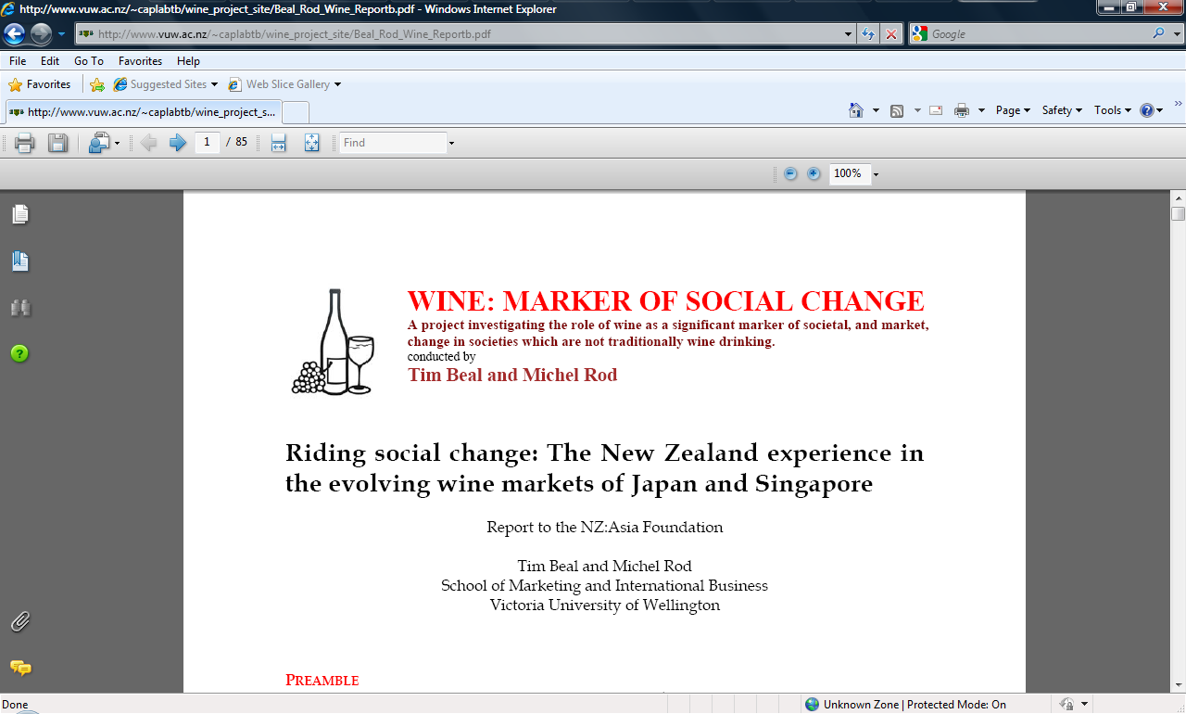
Wine research

Slide 5
Cultural intermediaries
those individuals who serve to provide a ‘bridge’ between different cultures; as cultural intermediaries - how they influence ‘taste’ and the process of foreign culture assimilation/incorporation.

Slide 6
Cultural intermediary usually people

Slide 7
But also media Kami no shizuku>>Korea

Slide 8

Conference – Budapest, Hungary, September 2010
26th IMP Conference 2010 Business Networks – Globality, Regionality, Locality AGENTS OF GLOBALITY: THE ROLE OF CULTURAL INTERMEDIARIES IN THE WINE MARKETS OF JAPAN AND SINGAPORE
Michel Rod (Carleton University, Canada)
Tim Beal (Victoria University of Wellington, NZ)
Nick Ellis (University of Leicester, UK)

Slide 9
FTA research
Complements micro research on customers, cultural intermediaries, etc
Macroeconomic environment in which actors play their roles in markets

Slide 10
KIEP Working Paper
Reports, government websites, media articles, etc
Statistics
KIEP library (Jeong YeunJu)
Interviews
Industry players (importers, distributors)
Trade officials
KIEP experts
Dr Kitae Sohn, Dr Nakkyun Choi

Slide 11
Wine source countries in Korea’s FTA pipeline
D: Under consideration
C:Under negotiation
A: In effect
B: Concluded
Argentina
Australia
New Zealand
EU - France, Italy, Germany, etc.
US
Chile

Slide 12
Wine and Korea’s FTAs
Tariff on wine is 15%
Liquor tax: 30%
Education tax:10%
Value added tax: 10%
Complementarity
No substantial domestic wine production so no opposition to imports
Government sees it as a benefit with which to sell FTAs

Slide 13
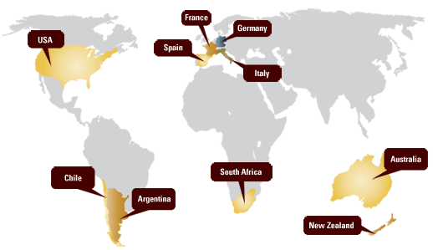
World of wine – Old and New

Slide 14
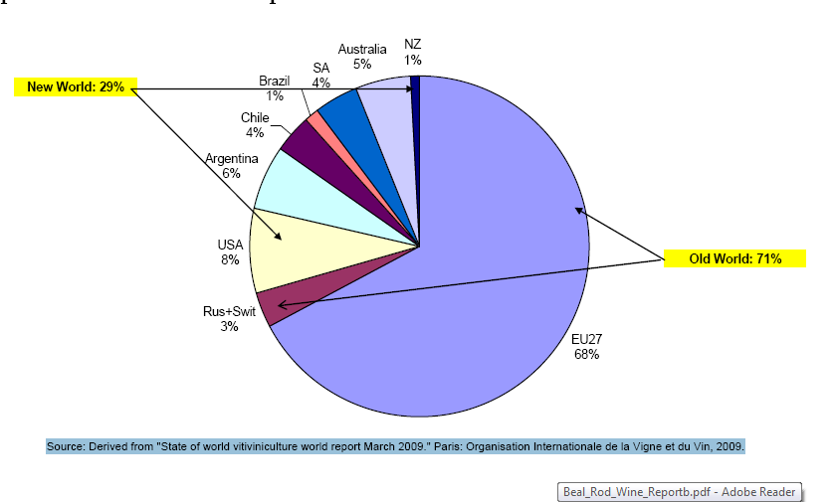
Old World versus New World World wine production 2008

Slide 15
Korean wine market
Main source countries in import profile
Wine in Korean alcohol market
Wine as imported alcohol
Imports of wine
Where does it come from?
Chile

Slide 16
Main wine source countries in Korea’s total imports,2009

Slide 17
Shares of main types in Korean alcohol market, 2006-8

Slide 18
Imported wines and spirits, 2004-9

Slide 19
Wine’s share of imported alcohols, 2004-2009

Slide 20
Korea’s imports of wine, 1990-2009

Slide 21
Where does the wine come from?
Highly concentrated
Seven countries = 60%
Ten countries= 95-98%
All in the FTA pipeline

Slide 22
Shares of top seven wine source countries, 1990-2009

Slide 23
French and German shares of Korea’s wine imports, 1990-2009

Slide 24
Korea’s wine imports from selected source countries, 1990-2009, by share

Slide 25
Korea’s wine imports, by type, 2003-9

Slide 26
Chile’s share of Korea’s wine imports, 1990-2009

Slide 27
Chile conundrum
FTA did not bring about a drop in prices of Chilean wine
But imports went up
What is happening?
Tariff reduction over five years
No great incentive for importers/ trade to lower prices

Slide 28
Government and industry
Chilean government and industry target Korea
Heavy promotion of Chilean wine
Korean wine importers get better returns from Chilean wines
Push Chilean wines
Korean government happy that wine is a ‘success story’

Slide 29
Customer perception
Chilean wines perceived to be better value for money ‘because no tariff’
Endorsement effect – Korea is endorsing Chilean products
Wine becomes ‘representative product of Chile’
Attention effect – much publicity
Positive image effect – Chile v China

Slide 30
Effect of future FTAs
EU comes in July 2010
US when?
Will increase competition, pressure on prices
Because of recession, industry (and customers) are used to discounted prices
Effects uncertain
Chile cannot be repeated
Wine industry is complex, future difficult to predict

Slide 31
Whence the Korean wine market?
Will wine market move to a new stage with the stimulus of EU FTA, and economic recovery?
Will wine become a ‘normal product?
Not just for celebrations, foreign meals, etc
Not to be dumped in hard times
Will it become indigenised?

Slide 32
Will wine become indigenised?
Precedents
Is beer thought of as ‘un-Korean’?
Other countries have gone through this process
Eg Britain, Australia, New Zealand.........
Unanswered question for discussion
Appreciate your views
One final thought, to cheer up economists

Slide 33
Thomas Carlyle
Described economics as the ‘dismal science’
But there is one consolation.......

Slide 34
Wine is about enjoyment

