Slide 1
Korea's FTAs and their implications for the Korean wine market
Tim Beal
Visiting Fellow, KIEP
Victoria University of Wellington, NZ
Lecture at Sogang University, Seoul, 27 October 2010

Slide 2
Outline
Free Trade Agreements
Korean wine market
Effect of FTA – Case of Chile
Implications

Slide 3
But first...
Something about me
Something about you
  Or your parents..........

Slide 5
Cluttered alcohol market

Slide 6
Country of origin very important
But sometimes they get it wrong!

Slide 7
Infuencers
Customers are influenced by
  Media
  (specialist) retailers
  Distributors
  Importers
  Sommeliers (wine waiters)
In countries where wine is not traditional these are cultural intermediaries

Slide 8
Media: Kami no Shizuku,/Les Gouttes de Dieu/Drops of God

Slide 9
Specialist retail

Slide 10
Distribution channels are key

Slide 11
Role of importers

Slide 12
Sommeliers

Slide 13
Cultural intermediaries
People who provide a bridge between two cultures
When wine comes to a country where it is not part of the tradition it needs cultural intermediaries
Japan, China.........Korea

Slide 14

Conference – Budapest, Hungary, September 2010
26th IMP Conference 2010
Business Networks – Globality, Regionality, Locality
AGENTS OF GLOBALITY: THE ROLE OF CULTURAL INTERMEDIARIES IN THE WINE MARKETS OF JAPAN AND SINGAPORE
Michel Rod (Carleton University, Canada)
Tim Beal (Victoria University of Wellington, NZ)
Nick Ellis (University of Leicester, UK)

Slide 15
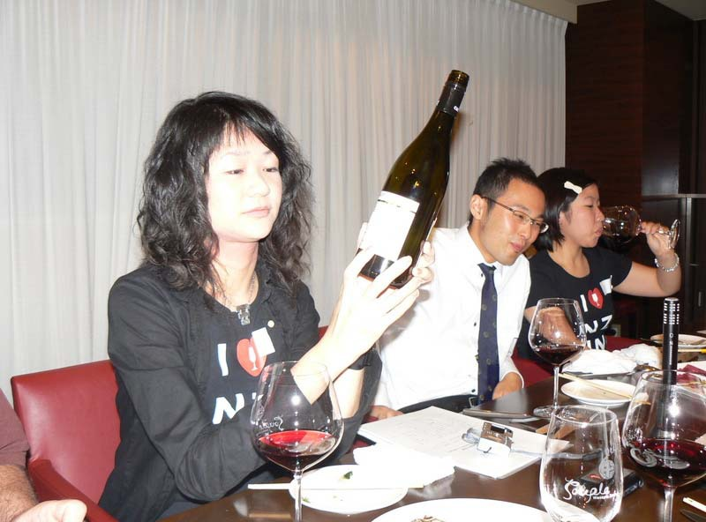
Customers seek knowledge

Slide 16
Researchers seek knowledge

Slide 17
Analysing wine can be hard work

Slide 18
But sometimes we have fun

Slide 19
FTAs
Free trade area is a type of trade bloc, a designated group of countries that have agreed to eliminate tariffs, quotas and preferences on most (if not all) goods and services traded between them. Countries choose this kind of economic integration form if their economical structures are complementary.

Slide 20
Multilateral FTAs
ASEAN Free Trade Area (AFTA)
Central American Integration System (SICA)
Central European Free Trade Agreement (CEFTA)^{[1]}
Common Market for Eastern and Southern Africa (COMESA)
G-3 Free Trade Agreement (G-3)
Greater Arab Free Trade Area (GAFTA) - June 1957^{[2]}
Gulf Cooperation Council (GCC)
North American Free Trade Agreement (NAFTA)^{[3]}
Southern African Development Community (SADC)
South Asia Free Trade Agreement (SAFTA)^{[4]}
Trans-Pacific Strategic Economic Partnership (TPP)^{[5]}

Slide 21
Bilateral FTAs
Many hundreds, eg
People's Republic of China has bilateral agreements with the following SARs, countries and blocs:
  ASEAN ASEAN–China Free Trade Area
  Chile
  Hong Kong Mainland and Hong Kong Closer Economic Partnership Arrangement (CEPA)
  Macau Mainland and Macau Closer Economic Partnership Arrangement (CEPA)
  Pakistan China – Pakistan Free Trade Agreement
  Peru China–Peru Free Trade Agreement
  New Zealand New Zealand – China Free Trade Agreement
  Thailand
  Singapore
  Taiwan Economic Cooperation Framework Agreement

Slide 22
Korea’s FTAs
FTAs in effect
- Korea-Chile FTA
- Korea-Singapore FTA
- Korea-EFTA FTA
- Korea-ASEAN FTA
- Korea-India CEPA
Concluded FTAs
- Korea-U.S. FTA
- Korea-EU FTA
- Korea-Peru FTA
FTAs under negotiation
- Korea-Canada FTA
- Korea-Mexico FTA
- Korea-GCC FTA
- Korea-Australia FTA
- Korea-New Zealand FTA
- Korea-Colombia FTA
- Korea-Turkey FTA
FTAs under consideration
- Korea-Japan FTA
- Korea-China FTA
- Korea-China-Japan FTA
- Korea-MERCOSUR TA
- Korea-Russia BEPA
- Korea-Israel FTA
- Korea-SACU FTA

Slide 23
Wine source countries in Korea’s FTA pipeline
D: Under consideration
C:Under negotiation
A: In effect
B: Concluded
Argentina
Australia
New Zealand
EU - France, Italy, Germany, etc.
US
Chile

Slide 24
Wine and Korea’s FTAs
Tariff on wine is 15%
  Liquor tax: 30%
  Education tax:10%
  Value added tax: 10%
Complementarity
  No substantial domestic wine production so no opposition to imports

Slide 25
You and wine
(Grape) wine is new to Korea
What is your experience/ perception?
What about your parents, grandparents?

Slide 26
Wine – where it comes from
Originally the Mediterranean
>>Old World wine
Transplanted with European settlement to the New World
>>>New World wine
Also ‘Emerging World wine’
  China, India, and other places where wine can be made

Slide 27
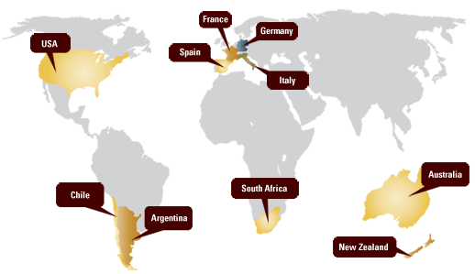
World of wine – Old and New

Slide 28
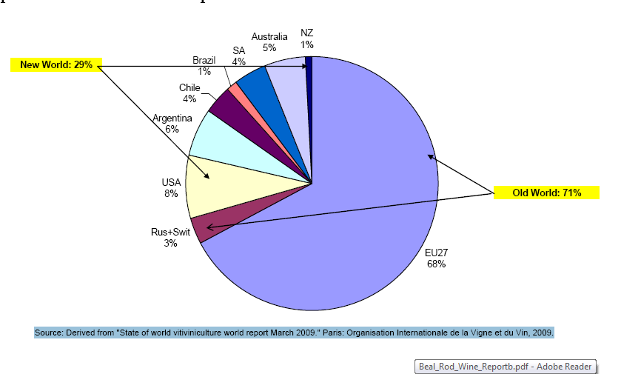
Old World versus New World
World wine production 2008

Slide 29
Korean wine market
Main source countries in import profile
Wine in Korean alcohol market
Wine as imported alcohol
Imports of wine
Where does it come from?
Chile

Slide 30
Main wine source countries in Korea’s total imports,2009

Slide 31
Shares of main types in Korean alcohol market, 2006-8

Slide 32
Imported wines and spirits, 2004-9

Slide 33
Wine’s share of imported alcohols, 2004-2009

Slide 34
Korea’s imports of wine, 1990-2009

Slide 35
Where does the wine come from?
Highly concentrated
Seven countries = 60%
Ten countries= 95-98%
All in the FTA pipeline

Slide 36
Shares of top seven wine source countries, 1990-2009

Slide 37
French and German shares of Korea’s wine imports, 1990-2009

Slide 38
Korea’s wine imports from selected source countries, 1990-2009, by share

Slide 39
Korea’s wine imports, by type, 2003-9

Slide 40
Chile’s share of Korea’s wine imports, 1990-2009

Slide 41
Chile conundrum
FTA did not bring about a drop in prices of Chilean wine
But imports went up
What is happening?
Tariff reduction over five years
  No great incentive for importers/ trade to lower prices

Slide 42
Government and industry
Chilean government and industry target Korea
  Heavy promotion of Chilean wine
Korean wine importers get better returns from Chilean wines
  Push Chilean wines
Korean government happy that wine is a ‘success story’

Slide 43
Customer perception
Chilean wines perceived to be better value for money ‘because no tariff’
Endorsement effect – Korea is endorsing Chilean products
Wine becomes ‘representative product of Chile’

Slide 44
Effect of future FTAs
EU comes in July 2010
  US when?
Will increase competition, pressure on prices
Effects uncertain
Chile cannot be repeated
Wine industry is complex, future difficult to predict
But...........

Slide 45
Wine is about enjoyment

